Slide 1
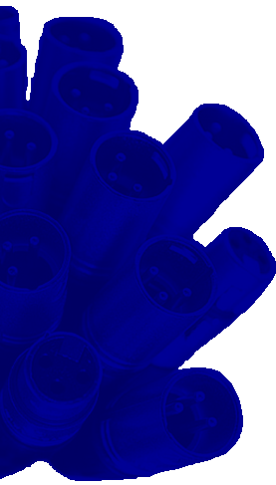

A Two-Pass Algorithm for Automatic Loudness Correction
141st AES Convention
Sept 29 – October 2, 2016
Los Angeles, CA
Convention paper 9683
Alexey Lukin, Russell McClellan, Aaron Wishnick
iZotope Inc., Cambridge, MA

Slide 2
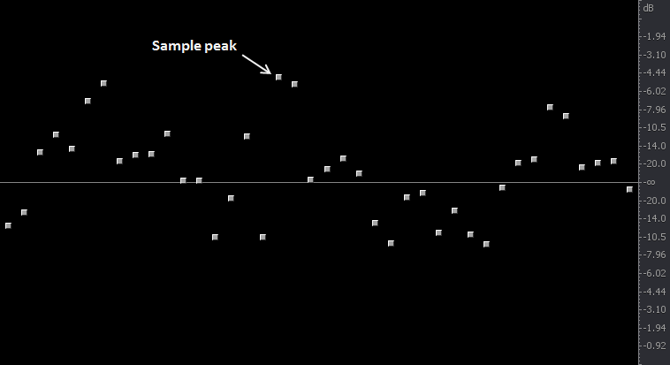
Level measurements
Traditional way: sample peak, RMS

Slide 3
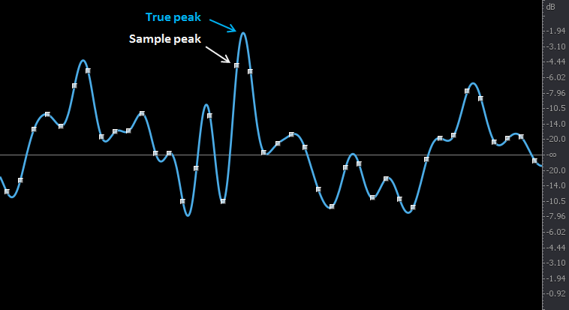
Level measurements
Traditional way: sample peak, RMS
New way: true peak, loudness (BS.1770)

Slide 4
Level measurements
Traditional way: sample peak, RMS
New way (BS.1770): true peak, loudness
  Integrated (programme) loudness
  Short-term and Momentary loudness

Slide 5

Level measurements
Traditional way: sample peak, RMS
New way (BS.1770): true peak, loudness
  Integrated (programme) loudness
  Short-term and Momentary loudness

Slide 6
True peaks
Part 1

Slide 7
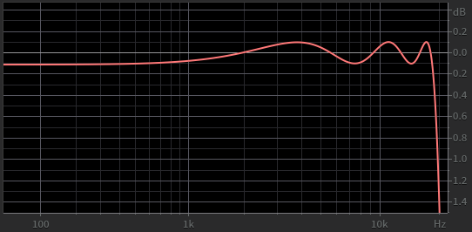
True peaks
BS.1770 upsampling filter
±0.1 dB
Equiripple filter design has ripples in both passband and stopband,
can underestimate peak levels

Slide 8
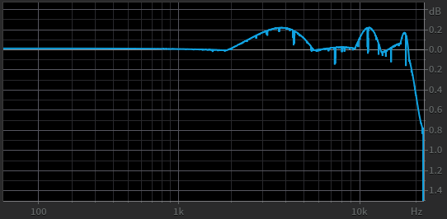
True peaks
Aliased (real-use) frequency response
Aliasing in measured levels created by sampling of 4× upsampled signal

Slide 9

True peaks
Improved filter design
  Reduced ripple
$$F\left(t\right)=\frac{sin\frac{πt}{U}}{\frac{πt}{U}}∙Kaiser\left(t\right), −16≤\frac{πt}{U}≤16, U=9$$

Slide 10
True peaks
Improved filter design
  Reduced ripple
  Peak finding by cubic interpolation
$$F\left(t\right)=\frac{sin\frac{πt}{U}}{\frac{πt}{U}}∙Kaiser\left(t\right), −16≤\frac{πt}{U}≤16, U=9$$

Slide 11
True peaks
Improved filter design
  Reduced ripple
  Peak finding by cubic interpolation
  Also using sample peak levels
$$F\left(t\right)=\frac{sin\frac{πt}{U}}{\frac{πt}{U}}∙Kaiser\left(t\right), −16≤\frac{πt}{U}≤16, U=9$$
$$\max\left\{ sample peak level, interpolated peak level \right\}$$

Slide 12
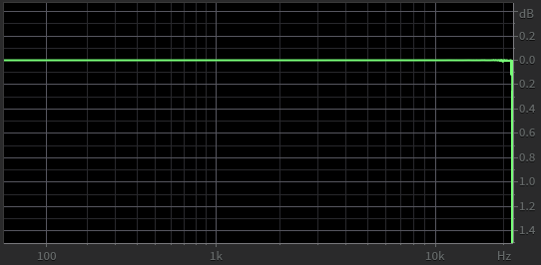
True peaks
Improved filter design
Aliased frequency response during practical use

Slide 13
True peaks
Improved filter design
*
Aliased frequency response during practical use
__________________________
* Is not compatible with the baseline BS.1770 upsampling filter

Slide 14
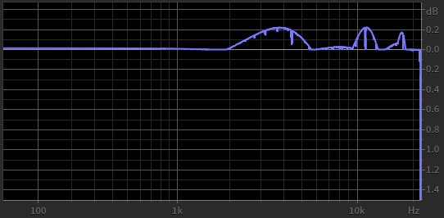
True peaks
Our solution:
$$\max\left\{ BS.1770 true peaks, improved true peaks \right\}$$
Aliased frequency response during practical use

Slide 15
Loudness correction algorithm
Part 2

Slide 16


Loudness correction
Flowchart of loudness correction
  Fixed gain to correct Integrated loudness
  Dynamic range compression for limiting Short-term/Momentary loudness (optional)
  True peak limiting
$$x(t)$$
Gain
(integrated)
Compression
(short-term/momentary)
Limiting
(true peaks)
$$y(t)$$

Slide 17
Loudness correction
  Easy to implement, single-pass operation
  Each stage of correction affects the result of other stages, e.g.: limiting changes the Integrated loudness
+
–
$$x(t)$$
Gain
(integrated)
Compression
(short-term/momentary)
Limiting
(true peaks)
$$y(t)$$

Slide 18
Loudness correction
Challenge: find the amount of gain G which achieves the required Integrated loudness, in anticipation of limiting
$$x(t)$$
Gain
(integrated)
Compression
(short-term/momentary)
Limiting
(true peaks)
$$y(t)$$

Slide 19

Loudness correction
Step 1: create the histogram of peak levels from the limiter envelope
popularity
level, dB

Slide 20
Loudness correction
Step 1: create the histogram of peak levels from the limiter envelope
True peak limiter threshold
popularity
level, dB

Slide 21
Loudness correction
Step 1: create the histogram of peak levels from the limiter envelope
True peak limiter threshold
popularity
Expected duration
of limiter activity
level, dB

Slide 22

Loudness correction
Step 2: create the histogram of momentary loudness
popularity
loudness, LKFS

Slide 23
Loudness correction
Step 2: create the histogram of momentary loudness
Translate the limiter threshold
popularity
Expected duration
of limiter activity
loudness, LKFS

Slide 24

Loudness correction
Step 3: “clip” the histogram to predict the effect of peak limiting on loudness
popularity
loudness, LKFS

Slide 25

Loudness correction
Step 4: recalculate Integrated loudness from the updated histogram
$$L_{i}$$
popularity
loudness, LKFS

Slide 26
Loudness correction
Step 5: update the required gain G and go to step 2

Slide 27
Loudness correction
Step 5: update the required gain G and go to step 2
This iterative process updates the histogram of momentary loudness based on the expected amount of peak (and loudness) limiting until it converges on the required amount of gain G

Slide 28
Loudness correction
Once the gain G is determined, the whole processing chain is ready to be applied
$$x(t)$$
Gain
(integrated)
Compression
(short-term/momentary)
Limiting
(true peaks)
$$y(t)$$

Slide 29
Loudness correction
Once the gain G is determined, the whole processing chain is ready to be applied
Integrated loudness of the output may not exactly match the prediction
$$x(t)$$
Gain
(integrated)
Compression
(short-term/momentary)
Limiting
(true peaks)
$$y(t)$$

Slide 30
Evaluation
Tested products:
  iZotope RX Loudness Control,
  Nugen LM-Correct 2,
  Minnetonka AudioTools Focus for Loudness Control,
  iZotope RX (Loudness module),
  TC Electronic LC2n Loudness Correct,
  RTW CLC (Continuous Loudness Control)

Slide 31

Evaluation
Test conditions
  A collection of 6 audio samples with wide dynamic range and diverse genres
  Each sample processed with 3 sets of loudness targets:

Slide 32

Evaluation
True peak compliance

Slide 33

Evaluation
Integrated loudness compliance

Slide 34

Evaluation
Short-term/momentary loudness compliance

Slide 35
Results
Improved accuracy of Integrated loudness – best in class of non-iterative methods
Spot-on True peak and Short-term loudness

Slide 36

Results
CPU performance

Slide 37
Summary
Loudness correction cannot be done accurately in realtime: all targets are interrelated

Slide 38
Summary
Loudness correction cannot be done accurately in realtime: all targets are interrelated
2-pass (analyze/correct) software struggles to achieve accurate Integrated loudness

Slide 39
Summary
Loudness correction cannot be done accurately in realtime: all targets are interrelated
2-pass (analyze/correct) software struggles to achieve accurate Integrated loudness
The proposed method shows an improved precision

Slide 40
Your questions
?

